Slide 1
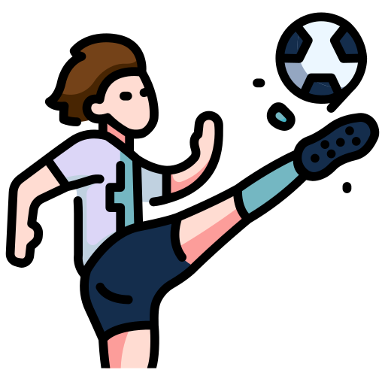
Pengajuan & Pengenalan Rencana Pembuatan Aplikasi
“PKS NESAS 2022”

Slide 2

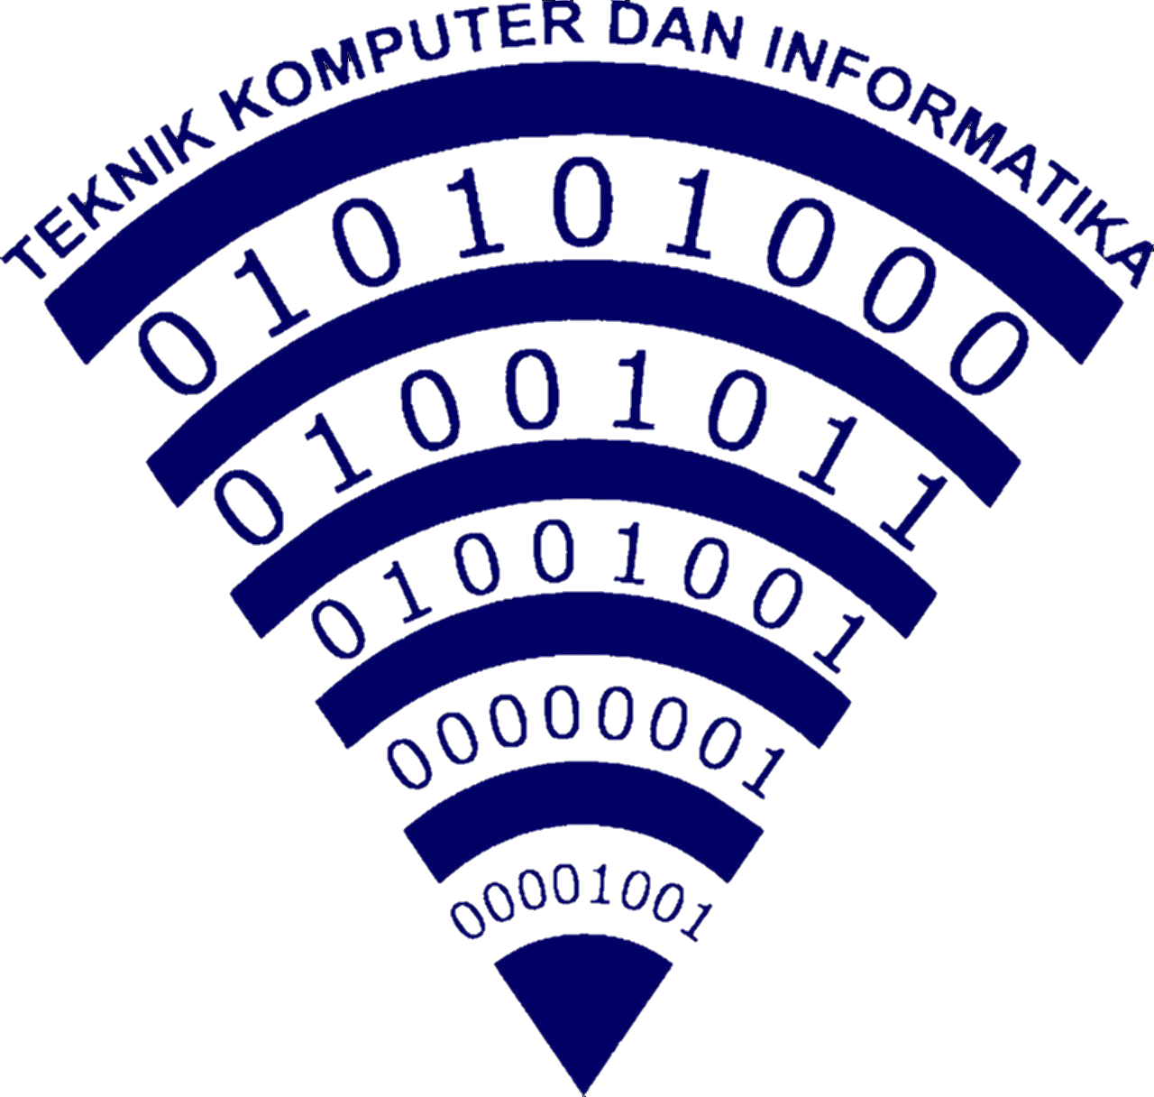

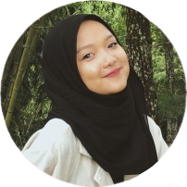
Firza Aurellia Iskandar
Disusun Oleh :
Rekayasa Perangkat Lunak
SMKN 1 SUBANG

Slide 3

Batasan Masalah
Aplikasi ini tidak bersifat daily usage, hanya untuk kebutuhan event PKS NESAS

Slide 4

RumusanMasalah
Bagaimana aplikasi ini dapat memudahkan warga SMKN 1 Subang untuk melihat update pertandingan pada acara Pekan Kreatifitas Siswa 2022.
Semoga cepet nemu

Slide 5


Tujuan
1. Untuk membuat jejak digital perihal update point, score, klasemen, dan lain lain, dalam bentuk aplikasi ringkas yang dapat dilihat & diakses oleh seluruh warga SMKN 1 Subang agar tidak terjadi kecurangan.
2. Dengan membuat tampilan semenarik mungkin merupakan salah satu teknik marketing yang bertujuan agar pengguna nyaman dan membuat event PKS 2022 ini berkesan.

Slide 6
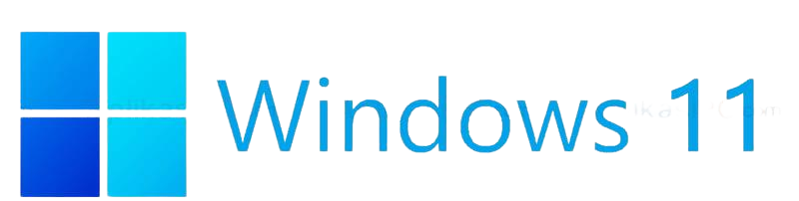
OPERATING SYSTEM YANG DI GUNAKAN

Slide 7




SOFTWARE YANG DI GUNAKAN
Flutter
Visual Studio Code
Sebagai code editor untuk merealisasikan desain yang telah saya buat di figma menjadi app sungguhan.
Sebagai code editor yang dapat merealisasikan desain yang telah saya buat di figma menjadi app sungguhan.
Dart
Figma
Sebagai bahasa turunan flutter yang sama sama diciptakan oleh google yang saya gunakan untuk project ini.
Sebagai wadah untuk menuanhkan ide ide saya khususnya di bagian front endnya sebelum selanjutnnya di proses di visual studio code.

Slide 8

SOFTWARE YANG DI GUNAKAN
Firebase
Sebagai database yang berfungsi untuk menyimpan data dan menyinkronkannya ke pengguna.

Slide 9
PROGRESS SAMPAI DENGAN 9 MEI 2022
75%
10%
0%
UI/UX DESIGN
Slicing Ke Flutter
Database
Mercury is the smallest planet
Neptune is far away from Earth

Slide 10

Fonts & Warna Yang Digunakan :
Titilium Web
(https://fonts.google.com/specimen/Titillium+Web?query=titi)
#142D4C
#DCD6F7
#FFFFF

Slide 11
KRITIK & SARAN

Slide 12
“This is a quote, words full of wisdom that someone important said and can make the reader get inspired”
—SOMEONE FAMOUS

Slide 13
01
Apa itu PKS NESAS 2022?
You can enter a subtitle here if you need it

Slide 14
02
VENUS
You could enter a subtitle here if you need it

Slide 15
MAYBE YOU NEED TO DIVIDE THE CONTENT
VENUS
MERCURY
Venus has a beautiful name and is the second planet from the Sun
Mercury is the closest planet to the Sun and the smallest one

Slide 16
HERE YOU HAVE SIX COLUMNS
MERCURY
NEPTUNE
MARS
EARTH
JUPITER
SATURN
Mercury is the closest planet to the Sun
Neptune is very far away from Earth
Despite being red, Mars is a cold place
Earth is the planet where we live on
Jupiter is the biggest planet of them all
Saturn is a gas giant and has several rings

Slide 17
MAKE YOUR POINTS CLEAR
Do you know what helps you make your points clear? Lists like this one:
They’re simple
You can organize your ideas clearly
You’ll never forget to buy milk!
And the most important thing: the audience won’t miss the point of your presentation

Slide 18
CONTENTS OF THIS TEMPLATE
Here’s what you’ll find in this Slidesgo template:
A slide structure based on a multi-purpose presentation, which you can easily adapt to your needs. For more info on how to edit the template, please visit Slidesgo School or read our FAQs.
An assortment of pictures and illustrations that are suitable for use in the presentation can be found in the two alternative resources slides.
A thanks slide, which you must keep so that proper credits for our design are given.
A resources slide, where you’ll find links to all the elements used in the template.
Instructions for use.
Final slides with:
The fonts and colors used in the template.
A selection of illustrations. You can also customize and animate them as you wish with the online editor. Visit Storyset by Freepik to find more.
More infographic resources, whose size and color can be edited.
Sets of customizable icons of the following themes: general, business, avatar, creative process, education, help & support, medical, nature, performing arts, SEO & marketing, and teamwork.
You can delete this slide when you’re done editing the presentation.

Slide 19
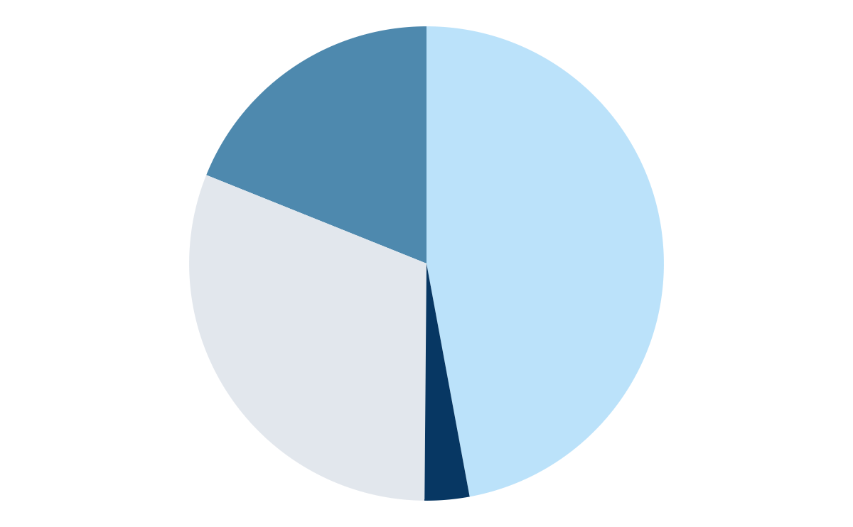
HERE YOU HAVE A GRAPH
18.8 %
Venus is the second planet from the Sun in the Solar System
31.0 %
47.1 %
Despite being red, Mars is a cold place full of iron oxide dust
Saturn is composed mostly of hydrogen and helium
3.0 %
Mercury is the smallest planet in the Solar System
To modify this graph, click on it, follow the link, change the data and paste the new graph here

Slide 20
PROGRESS
15%
70%
0%
10%
Per 9 Mei 2022
Mercury is the smallest planet
Desain UI/UX di Figma
Database
Slicing ke flutter

Slide 21
HERE ARE SOME IMPORTANT DATES
23
13
4
APRIL
JULY
SEPTEMBER
Neptune is far away from Earth
Saturn is a gas giant and has rings
Mercury is the smallest planet

Slide 22
THIS IS A TABLE
 | PROJECT 1 | PROJECT 2 | PROJECT 3
JUPITER | 6,000 | 32,000 | 87,000
MARS | 12,000 | 56,000 | 90,000

Slide 23
THIS IS A MAP
MARS
MERCURY
Mars is actually a cold place
Mercury is the smallest planet
JUPITER
VENUS
Jupiter is the biggest planet
Venus has a beautiful name

Slide 24
HERE'S AN INFOGRAPHIC
MERCURY
Mercury is the smallest planet
JUPITER
Jupiter is the biggest planet
MARS
Mars is actually a cold place
VENUS
Venus has a beautiful name

Slide 25
PRICING
MARS
VENUS
SATURN
€12,000
€60,000
€100,000
Despite being red, Mars is actually a cold place
Venus is the second planet from the Sun
Saturn is a gas giant and has several rings

Slide 26
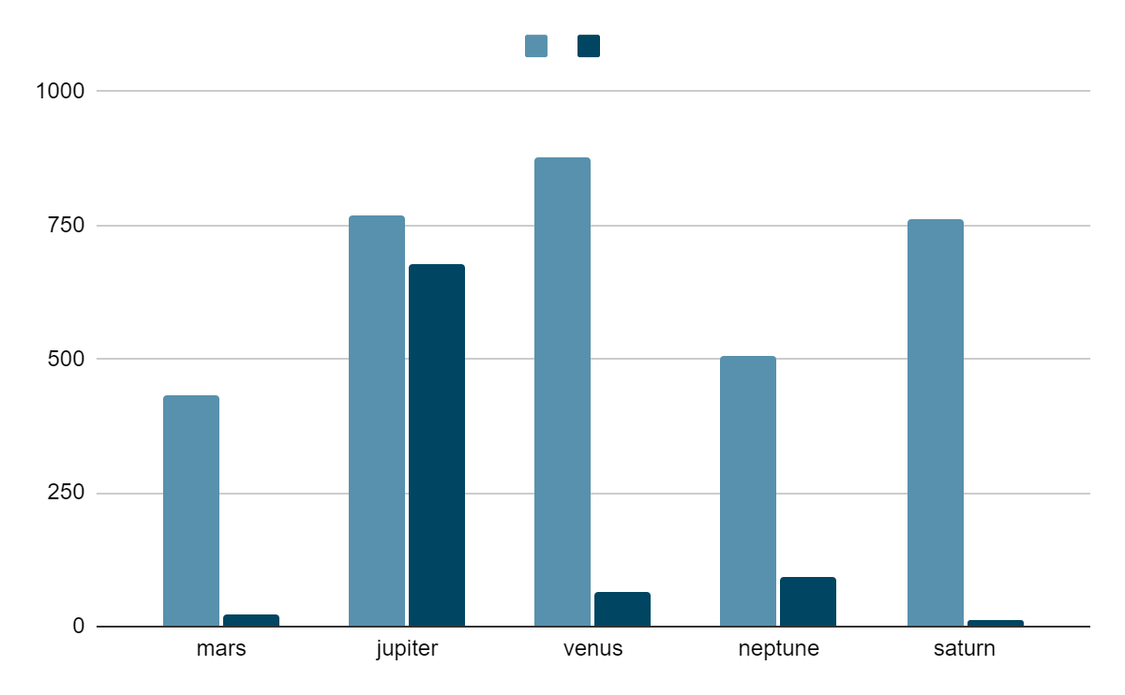
HERE YOU HAVE ANOTHER GRAPH
To modify this graph, click on it, follow the link, change the data and paste the new graph here
MERCURY
MARS

Slide 27
TIMELINE
MARS
MERCURY
VENUS
SATURN
Mars is actually a cold place
Mercury is the smallest planet
Venus is the second planet from the Sun
Saturn is a gas giant and has several rings

Slide 28
THIS IS ANOTHER TIMELINE
MARS
VENUS
MERCURY
SATURN
Despite being red, Mars is a cold place
Venus is the second planet from the Sun
Mercury is the closest planet to the Sun
Saturn is a gas giant and has several rings

Slide 29
THANKS
Do you have any questions?
addyouremail@freepik.com +91 620 421 838 yourcompany.com
Please keep this slide for attribution

Slide 30
ALTERNATIVE RESOURCES
VECTORS
PHOTOS
Alone concept illustration
Cloud hosting concept illustration
Inbox cleanup illustration concept
Grades concept illustration
Goal concept illustration
Stress concept illustration
Checklist concept illustration
Processing concept illustration
Search engine concept illustration
Winners concept illustration
Launching concept illustration
Front view young man working from home
Smiley man working on laptop from home
Mid section of young man using smartphone with laptop
Positive businessman using laptop
Business people working on a new project
Employees wearing face masks at the office

Slide 31
RESOURCES
VECTORS
PHOTOS
Social ideas concept illustration
Page not found with people connecting a plug concept illustration
Image concept illustration
Organizing projects concept illustration
Mind map concept illustration
At work concept illustration
Conversation concept illustration
Email campaign concept illustration
Person working on laptop at table
Person working on laptop
Person working on laptop and mobile
People working together for a new project
STORYSET
Visual data

